Slide 1
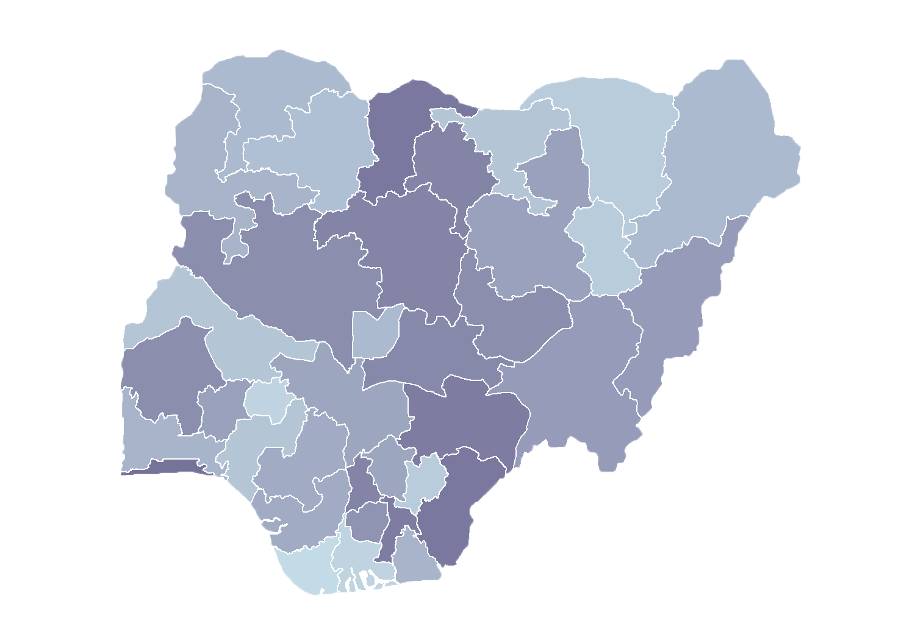
Module 2.2
Approval Workflows
Rollout of Health Facility Registry/Master Facility List
for States and Local Government Areas
in Nigeria
June 2019

Slide 2
Outline
Introduction
Facility record verification
Facility record validation
Facility record publication
Approvals status

Slide 3
Introduction
Standard operating procedures
Nigeria’s Federal Ministry of Health convened a workshop on MFL/HFR standard operating procedures (SOPs) for the Master Facility List (MFL)/Health Facility Registry (HFR) in October 2018.
Invited representatives of the Department of Planning, Research and Statistics and the department or agency responsible for facility registration for 17 states
Invited representatives of federal regulatory bodies and the National Primary Health Care Development Agency
Inventoried a range of procedures followed by different states for registering facilities and changing their status
Next, developed and shared draft SOPs based on the consultative process with workshop participants and the MFL Technical Working Group (TWG)
Finalized SOPs validated by the MFL TWG in November 2018

Slide 4
Introduction
SOPs
SOPs allow all offices responsible for facility management to have a standard process to engage with the MFL by defining facility management workflows for these tasks:
  Creating new records for health facilities
  Updating records for health facilities already registered
  Deactivating records for health facilities that have closed
The SOPS that have been configured in the HFR are sufficiently flexible that they may be adapted to specific workflows, which may vary from state to state.

Slide 5
Introduction
Approval levels
Any change of facility information (creating a new facility record or updating an existing facility record) will require three approvals before the changes are visible to the public.
Approval levels:
  Facility record verification
  Facility record validation
  Facility record publication

Slide 6
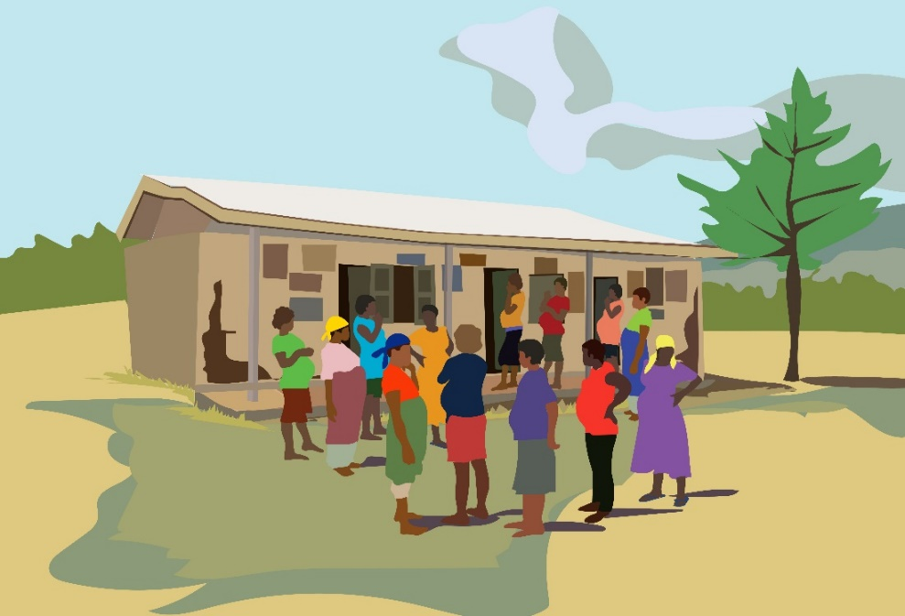
Facility record verification

Slide 7
Facility record verification
Once the request to create, update, or delete a facility record is submitted, if you have been assigned a verification role, you will receive a notification email.
Log in to the HFR.
Go to My Pending Approvals -> Verification.
A list of pending requests will be displayed.

Slide 8
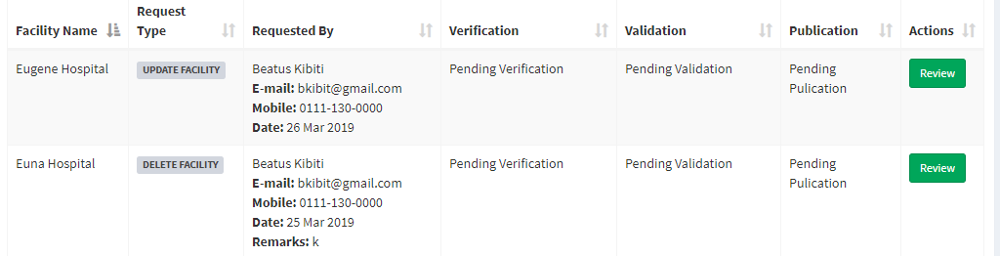
Facility record verification
Pending verifications

Slide 9
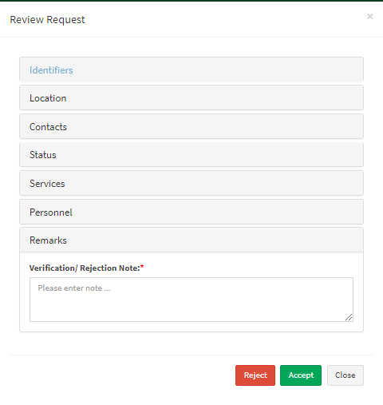
Facility record verification
Click Review for the record you want to check.
A form with facility details will be shown.
Confirm that the facility information is correct.
Enter verification or rejection notes, depending on the review outcome.
To accept, click Accept.
To reject, click Reject.

Slide 10
Facility record verification
An accepted request will go to next level of validation.
A rejected request will go back to the requester.
Undo verification:
  You can recall a verification action before it is validated.
  Recall will change the facility status to what it was before verification.

Slide 11
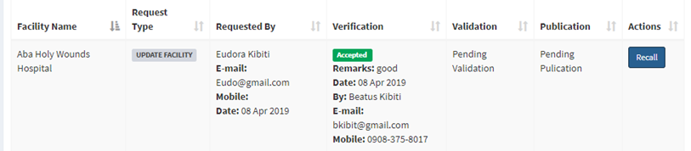
Facility record verification
Recall
Once you submit a change for verification, you will see a Recall button if the validation is pending.
Click Recall. You will get this prompt: “Are you sure you want to recall verification for this facility?”
Click Yes to confirm or No to cancel.

Slide 12
Demonstration
Notes:
Demonstrate how to verify
Show how status changes for each approval

Slide 13
Facility record
validation

Slide 14
Facility validation
Validation is the second level of approval.
Once the request has been verified, if you have a validation role you will receive a notification email.
Go to My Pending Approvals -> Validation.
A list of requests for validation will be displayed with the details about the requester and verifier.

Slide 15
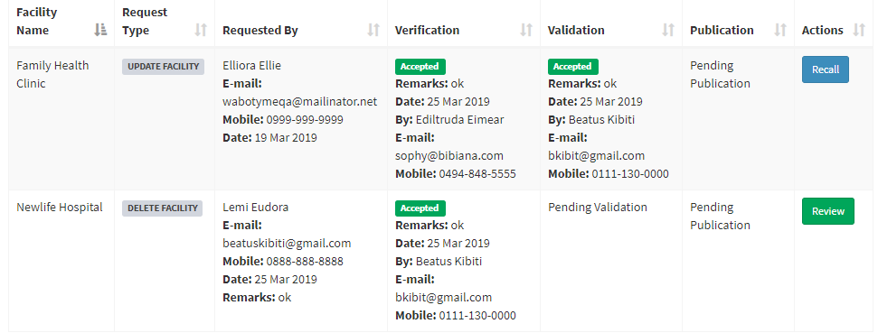
Facility record validation

Slide 16
Facility record validation
To validate the request, click Review.
A form with facility details will be shown.
Enter a validation or rejection note, depending on the review outcome.
To validate, click Accept.
To reject, click Reject.

Slide 17
Facility record validation
A validated request will go to the next level of publication.
A rejected request will go back to the verifier.
Undo validation:
  You can recall a validation action before a record is published.
  Recall will change the facility status to what it was before validation.

Slide 18
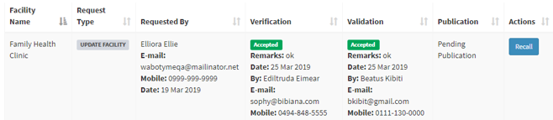
Facility record validation
Recall
Once you submit a validation, you will see a Recall button if the publication is pending.
Click Recall. You will get this prompt: “Are you sure you want to recall validation for this facility?”
Click Yes to confirm or No to cancel.

Slide 19
Demonstration
Notes:
Demonstrate how to validate request
Show how status changes for each approval

Slide 20
Facility record
publication

Slide 21
Facility record publication
Publishing is the third and final approval level.
You may publish a record only if you have been assigned that role.
Once a request is validated, as publisher you will receive a notification email.
Go to My Pending Approvals -> Publication
A list of requests for publication will be displayed with details about the requester, verifier, and validator.

Slide 22
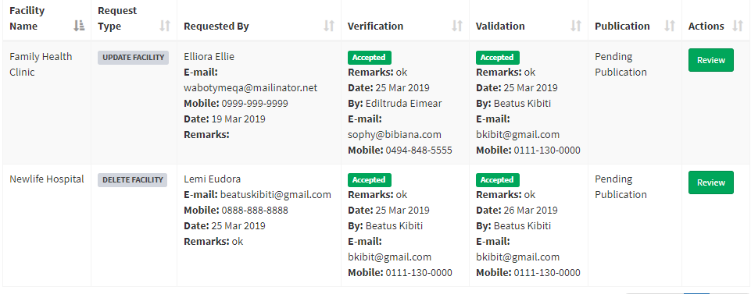
Facility record publication

Slide 23
Facility record publication
To publish the request, click Review.
A form with facility details will be shown.
Enter a publication or rejection note, depending on the review’s outcome.
To publish, click Accept.
To reject, click Reject.

Slide 24
Facility record publication
A rejected request will go back to the validator.
Once the request is published, information will be visible to the public.
Publication cannot be undone.
To change published information, the process must start from beginning: a user will submit an update request and follow the approval processes.

Slide 25
Demonstration
Notes:
Demonstrate how to publish
Show how status changes for each approval

Slide 26
Approvals
status

Slide 27
Approvals status
Creating a new facility record
Status
New Facility
Submit Request
New Facility Requested
Verification
Verified
Rejected
Request Verified
Verification Rejected
Validation
Validated
Rejected
Request Validated
Validation Rejected
Publication
Published
Rejected
New Facility Published
Publishing Rejected

Slide 28
Approvals status
Updating a facility record
Status
Update Facility
Submit Request
Update Requested
Verification
Verified
Rejected
Request Verified
Verification Rejected
Validation
Validated
Rejected
Request Validated
Validation Rejected
Publication
Published
Rejected
Update Request Published
Publishing Rejected

Slide 29
Approvals status
Deleting a facility record
Status
Delete Facility
Submit Request
Deletion Requested
Verification
Verified
Rejected
Request Verified
Verification Rejected
Validation
Validated
Rejected
Request Validated
Validation Rejected
Publication
Published
Rejected
Deletion Published
Publishing Rejected

Slide 30

Activity

Slide 31
Practice
Approvals
Verify all facility record requests sent to you.
Validate all facility record requests sent to you.
Publish all requests sent to you.
Note status changes as you approve or reject the requests.

